Slide 1
UBER FARE PREDICTION USING MACHINE LEARNING
- By Bhaskar Adhikary

Slide 2
INTRODUCTION
The project is about on world's largest taxi company Uber inc. In this project, we're looking to predict the fare for their future transactional cases. Uber delivers service to lakhs of customers daily. Now it becomes really important to manage their data properly to come up with new business ideas to get best results. Eventually, it becomes really important to estimate the fare prices accurately.

Slide 3
DATASET
key - a unique identifier for each trip
fare_amount - the cost of each trip in usd
pickup_datetime - date and time when the meter was engaged
passenger_count - the number of passengers in the vehicle (driver entered value)
pickup_longitude - the longitude where the meter was engaged
pickup_latitude - the latitude where the meter was engaged
dropoff_longitude - the longitude where the meter was disengaged
dropoff_latitude - the latitude where the meter was disengaged

Slide 4
OBJECTIVE
Understand the Dataset & cleanup (if required).
Build Regression models to predict the fare price of uber ride.
Also evaluate the models & compare thier respective scores like R2, RMSE, etc

Slide 5
Stractegic Plan of Action
We aim to solve the problem statement by creating a plan of action, Here are some of the necessary steps:
Data Exploration
Exploratory Data Analysis (EDA)
Data Pre-processing
Data Manipulation
Feature Selection/Extraction
Predictive Modelling
Project Outcomes & Conclusion

Slide 6
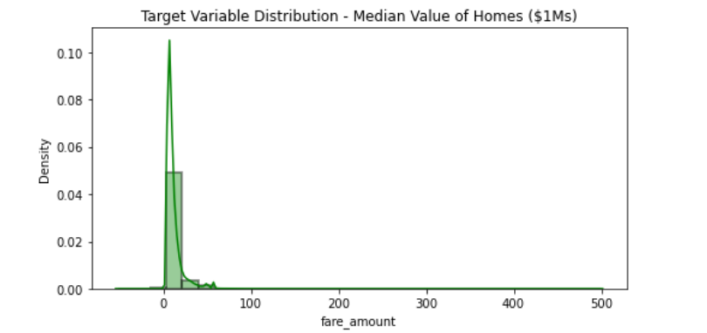
Target variable
The Target Variable seems to be be highly skewed, with most datapoints lieing near 0

Slide 7
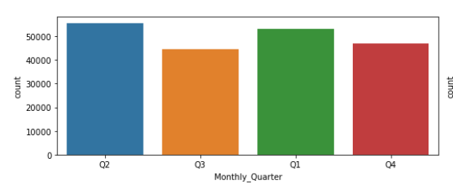
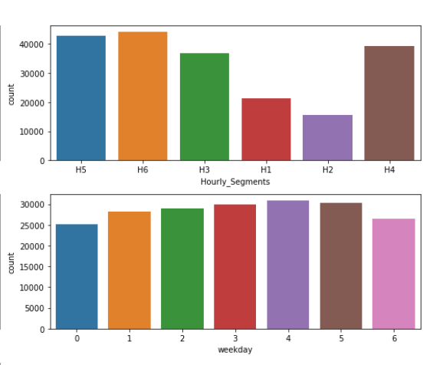
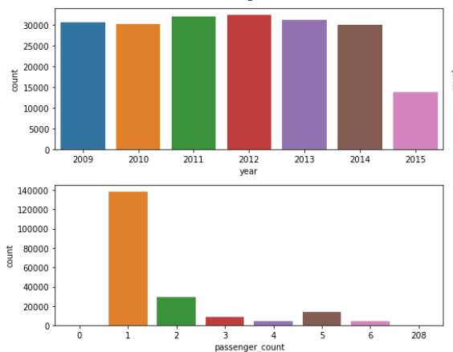
Visualising the categorical features

Slide 8
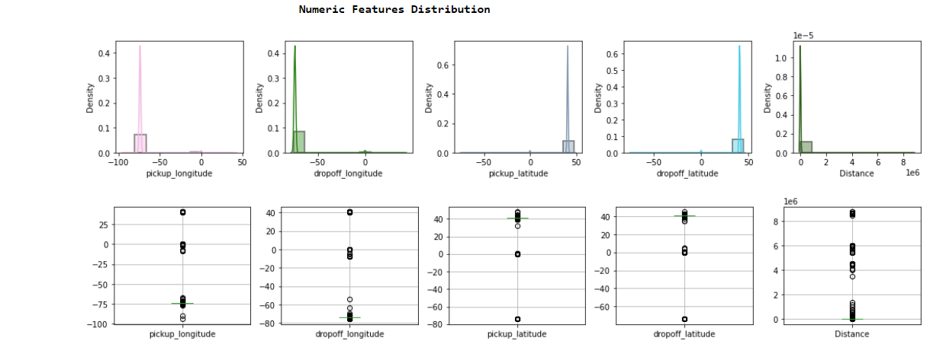
Visualising the numeric features
There seem to be some outliers. let us fix these in the upcoming section...

Slide 9
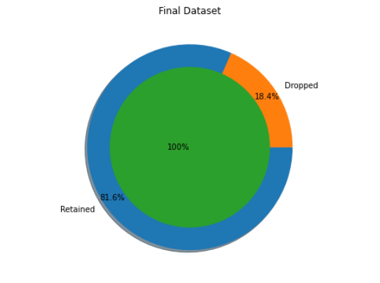
Dataset size after performing Preprocessing
After the cleanup process, 36784 samples were dropped, while retaining 18.39% of the data.\

Slide 10
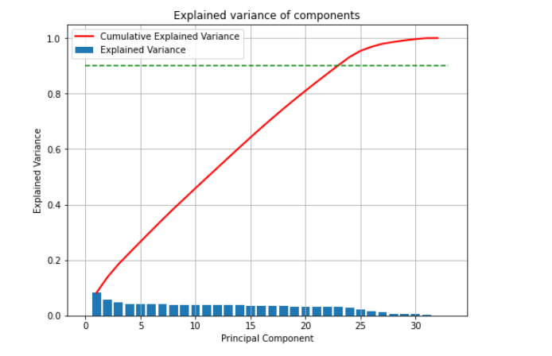
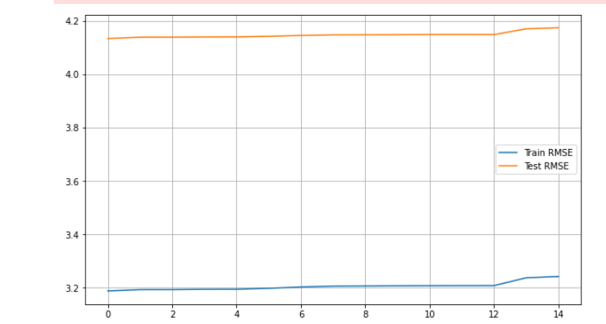
Manual Method - VIF

Slide 11
Predictive Modelling

Slide 12
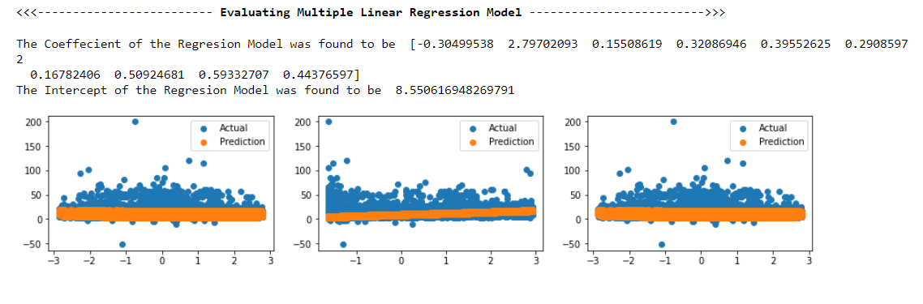
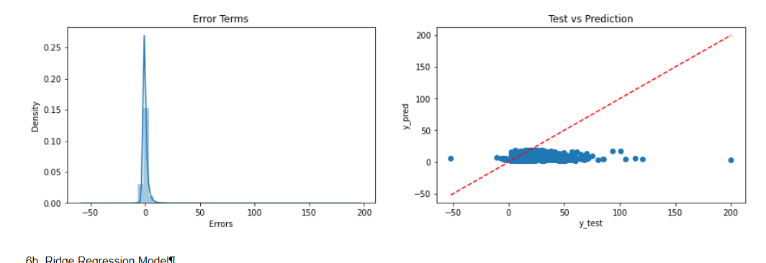
Multiple Linear Regression(MLR)

Slide 13
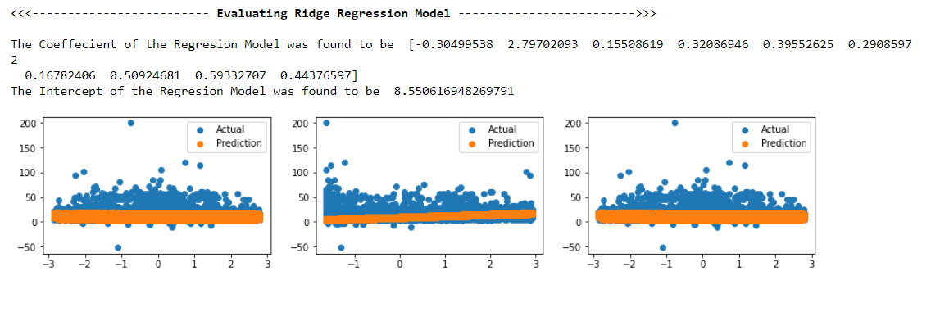
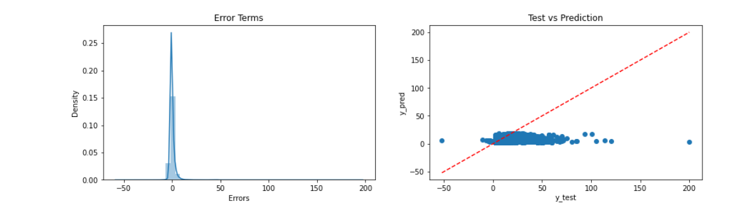
Ridge Regression Model

Slide 14
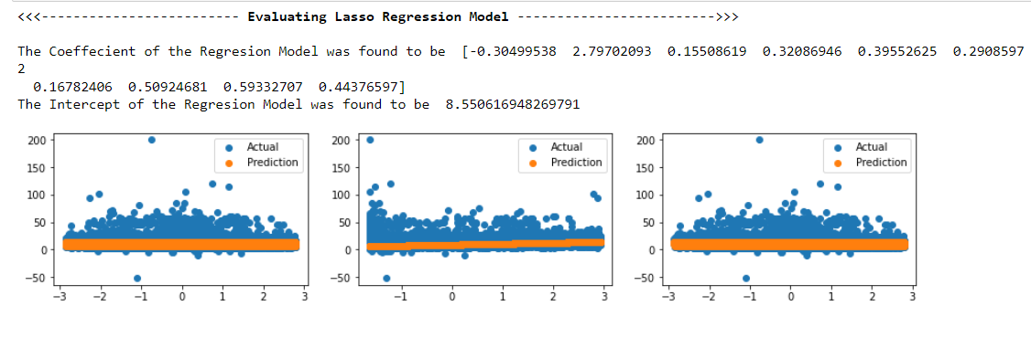
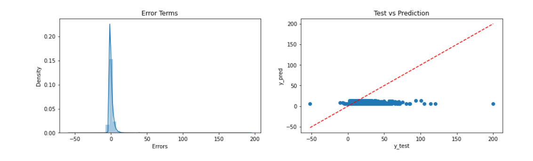
Lasso Regression Model

Slide 15
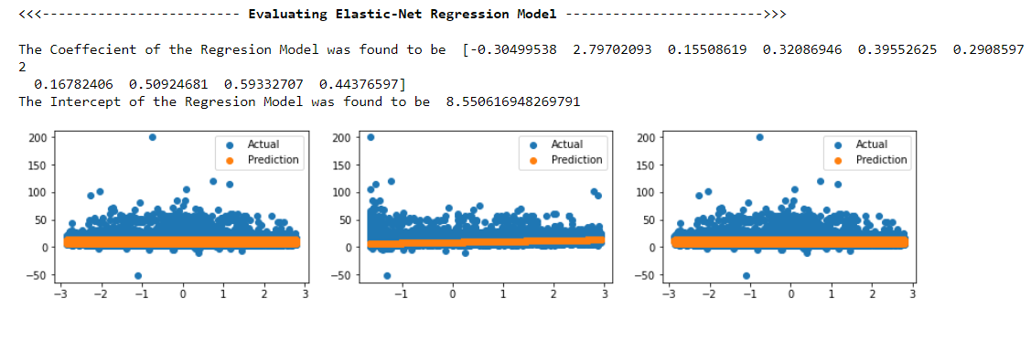
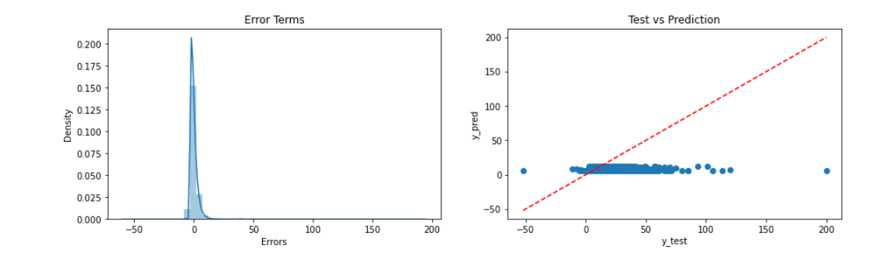
Elastic-Net Regression

Slide 16
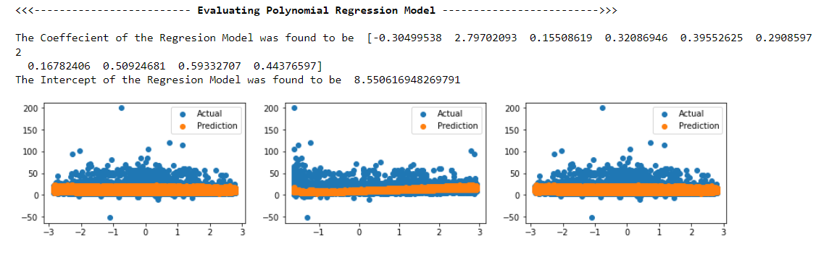
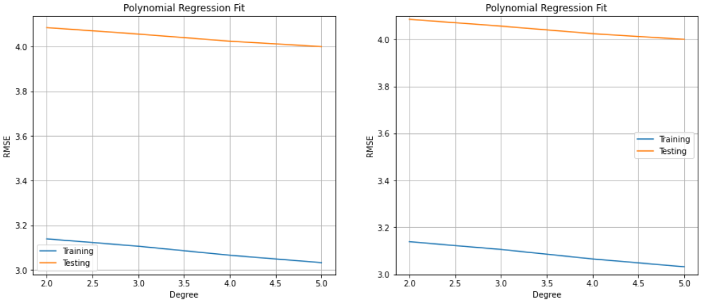
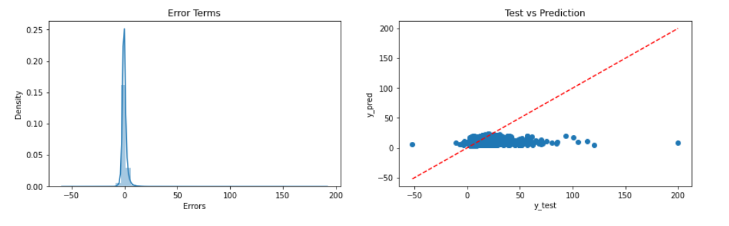
Polynomial Regression Model

Slide 17
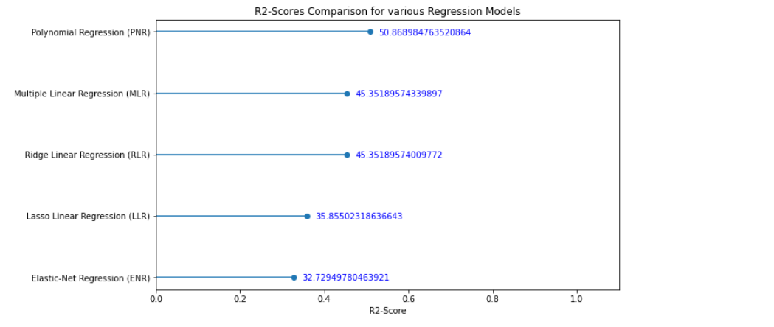
Comparing the Evaluation Metrics of the Models
From the above plot, it is clear that the polynomial regresion models have the highest explainability power to understand the dataset.

Slide 18
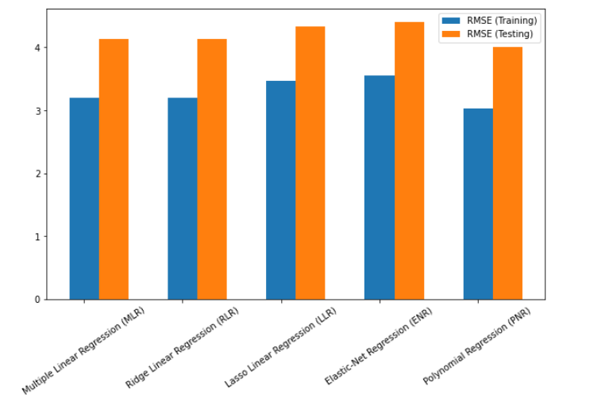
Root Mean SquaredError Comparison for different Regression Models
The complex models like polynomial (degree-5) performs the best on the current dataset. For this problem, it is can be said that even simple regression can be a good choice to go with..

Slide 19
Project Outcomes & Conclusions
Visualising the distribution of data & their relationships, helped us to get some insights on the feature-set.
The features had high multicollinearity, hence in Feature Extraction step, we shortlisted the appropriate features with VIF Technique.
Testing multiple algorithms with default hyperparamters gave us some understanding for various models performance on this specific dataset.
While, Polynomial Regression was the best choise, yet it is safe to use multiple regression algorithm, as their scores were quiet comparable & also they're more generalizable.

Slide 20
THANK YOU

